Slide 1
Expanding Networks
That’s easy! A network of exchange is a web of connections through which people, goods, and ideas circulate. Telephones, the Internet, and highways are all networks of exchange.
Hmmm... What is a network of exchange?

Slide 2
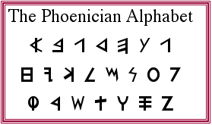
Expanding Networks
Routes Around 300 BCE to 300 CE, merchants, shippers, sea captains, and empire-builders extended and strengthened trade routes across Afroeurasia and the Americas.
Empires Empires required networks of military and political communication. These networks encouraged interaction of many kinds over long distances.
Writing With the appearance of alphabetic writing systems in Afroeurasia, people could communicate faster and easier than ever before.
Religions The appearance of world religions— Hinduism, Judaism, Buddhism, and Christianity—stimulated cultural interchange across political and cultural boundaries.

Slide 3
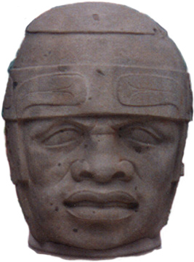
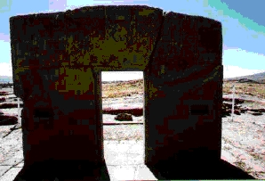
Expanding Networks: Routes
In the Americas...
The Olmec of Mexico developed extensive trade networks that extended hundreds of miles from Olmec territory. They imported jade and other raw materials for their crafts. Their exports included pottery and sculpture.
The Tiwanakans in what is today Bolivia also began to build trade routes during Big Era Four. Llama caravans brought produce, wood, metals, and fish from outlying villages to the city of Tiwanaku.

Slide 4
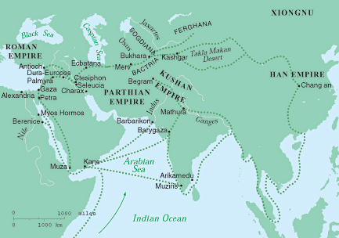
Expanding Networks: Routes
The silk road, Persian royal road, Roman roads, and shipping routes combined to form extensive interregional networks of exchange in Afroeurasia.
A wide variety of goods flowed along these networks…

Slide 5
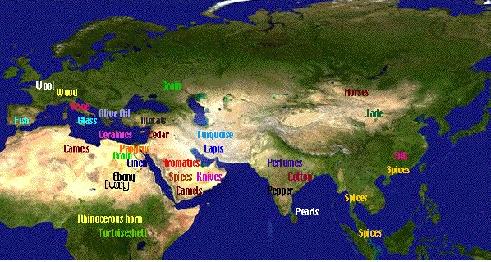
On the map are some of the
goods traded along the
Afroeurasian networks.
Expanding Networks: Routes

Slide 6
Expanding Networks: Routes
A number of large states, or empires, appeared in Big Era Four.
Empire-builders had to move troops and supplies, dispatch messages, gather intelligence, and collect taxes.
These tasks required good systems of communication and transport by land and sea.
These systems were created mainly to serve the empire’s government and army.
But they also served as highways of commerce, cultural exchange, and migration.
An empire is a state that unites many territories and diverse peoples under one ruler or government.

Slide 7
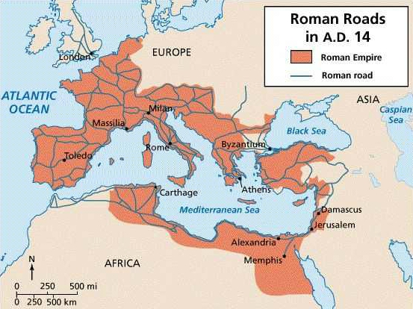
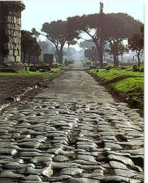
Expanding Networks: Routes
Roman Roads
The Romans built an extensive network of roads. Over 50,000 miles of paved roads, tracks, and trails radiated from the Forum in the center of Rome to all parts of the empire.

Slide 8
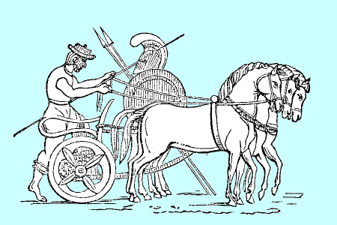
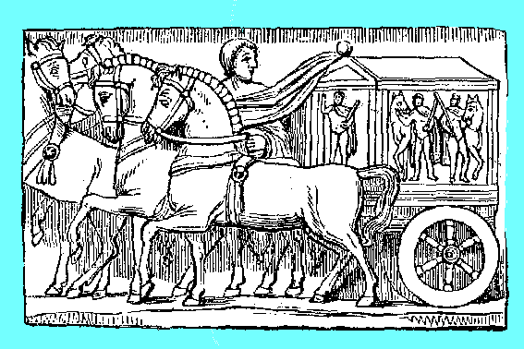
Expanding Networks: Routes
Though built primarily to speed troops and supplies, Roman roads were used for commercial purposes, too. Goods were shipped to distant provinces and beyond.
Constructed by skilled engineers, the roads were strong enough to support half-ton wagons and wide enough to allow two-way traffic.

Slide 9
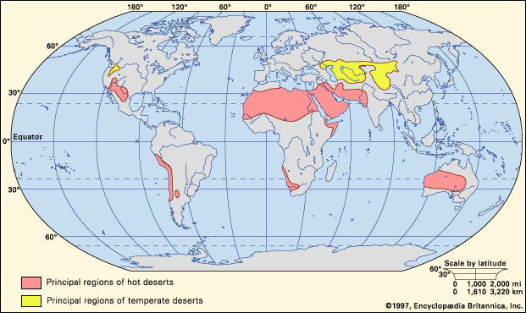
Expanding Networks: Routes
The Silk Roads was a network of roads, tracks, and trails ran across Inner Eurasia. Most of this region is part of the Great Arid Zone, the belt of dry country that extends
across Afroeurasia.
Inner Eurasia
Great Arid Zone
Notes:
Map: NASA, Earth Observatory, The Blue Marble
http://earthobservatory.nasa.gov/Newsroom/BlueMarble/

Slide 10
Expanding Networks: Routes
Inner Eurasia is a region of grassy steppes, rugged mountains, and forbidding deserts. This terrain is hard to cross. Despite these harsh conditions, humans have been carrying goods, ideas, and technologies along the Silk Roads of Inner Eurasia for millennia.
I n n e r E u r a s i a
1997, Encyclopedia Britannica Inc

Slide 11
Expanding Networks: Routes
Domestication of the horse, ox, and camel made humans more mobile.
About 3000 BCE, people in the steppes of Inner Eurasia began to take up pastoralism. Because they moved with their herds, they typically did not grow crops.
Instead, they traded with farmers and city-dwellers for food and other goods.
By 1000 BCE, pastoralists controlled networks of exchange throughout Inner Eurasia .

Slide 12
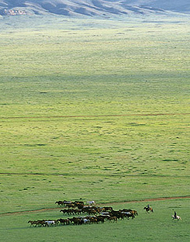
Expanding Networks: Routes
Between 300 BCE and 300 CE, long periods of stability and prosperity in states throughout Afroeurasia stimulated interest in long distance trade.
Intercontinental communication and the exchange of goods, became regular, organized, and protected by large empires.
The Silk Roads carried shipments of Chinese silk but also many other goods.
Notes:
http://www.kiku.com/electric_samurai/virtual_mongol/index.html

Slide 13
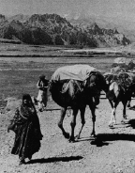
Expanding Networks: Routes
On the Silk Roads, goods changed hands many times. Parthians, Indians, Kushans, Uigurs, and others acted as middlemen, selling and bartering goods, and taking profits.
Caravans passing west carried silk, porcelain, jade, bronze, and spices.
Those traveling east shipped gold and silver coins, ivory, gemstones, glassware, and carpets.

Slide 14
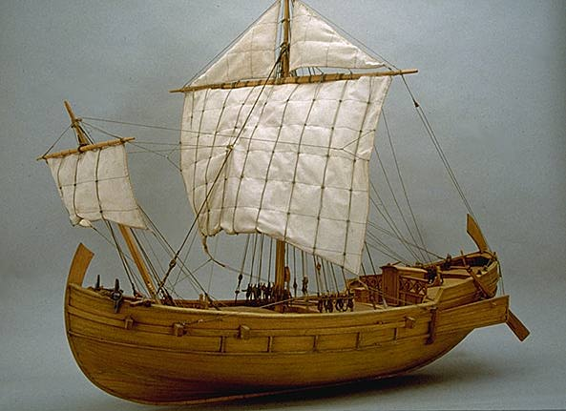
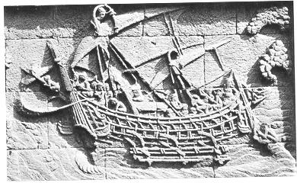
Expanding Networks: Routes
Roman Ship
Sea routes ran down the Red Sea and Persian Gulf, across the Arabian Sea and Bay of Bengal, and through the Straits of Malacca to the South China Sea.
Indian Ship
These sea lanes often linked up with overland routes, facilitating travel, trade, and the exchange of ideas across Afroeurasia.
Chinese Ship

Slide 15
Expanding Networks: Empires
Empires had formed in Afroeurasia as early as Big Era Three. Although many claimed vast territories, most did not survive for long.
In the 4th century BCE, Alexander the Great amassed an empire that stretched from Greece to India. Upon his death, however, the empire fragmented.
The later centuries of Big Era Four saw the rise of new empires that both dominated huge expanses of land and remained unified for a long time. The
Largest of these were the Han and Roman empires.

Slide 16
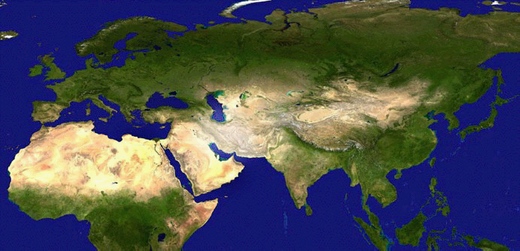
Large Empires of Afroeurasia
500 BCE - 500 CE
Rome
Byzantium
Kushana
Xiongnu
Parthian/
Sassanid
Han
Maurya/
Gupta
Kush
Axum

